Slide 1
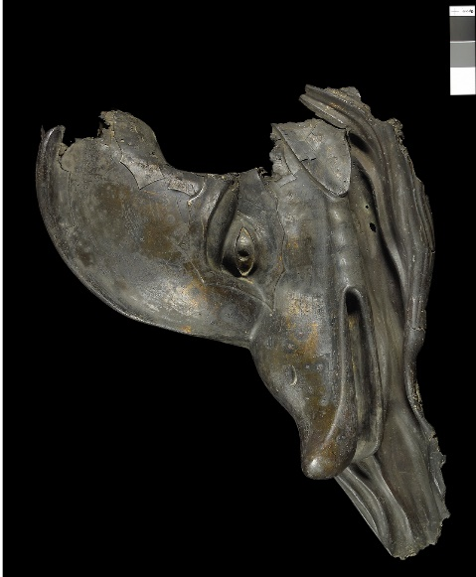
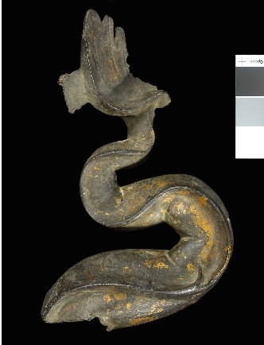
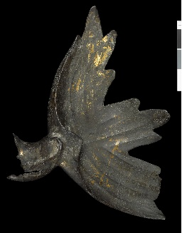
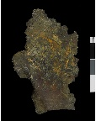
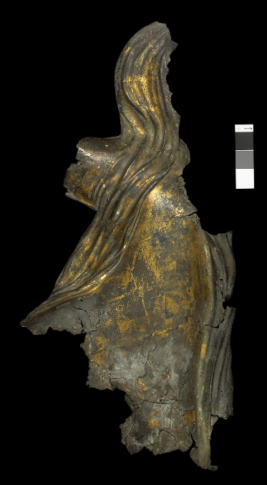
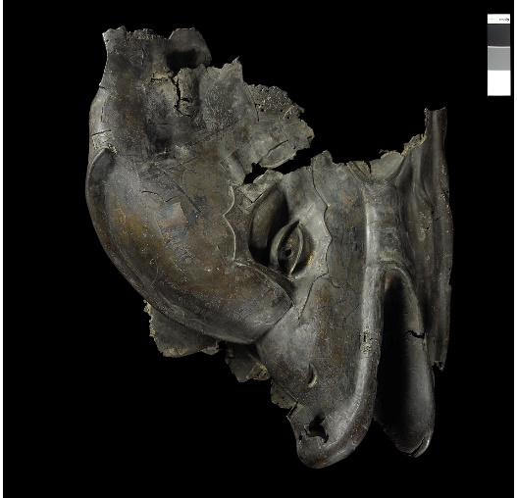
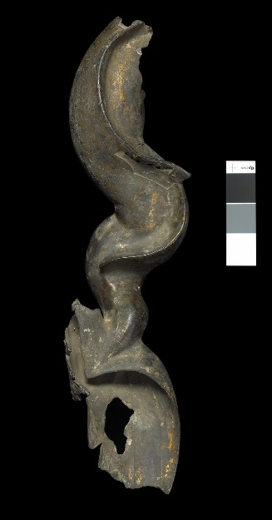
Case Study 1 - Reconsideration of a monumental Gallo-Roman relief : the Dolphins of Vienne (France)
FIG 934
FIG 940
FIG 942
FIG 932
FIG 938
FIG 936
FIG 944
The fragments of a unique, large-scale, gilded Gallo-Roman relief unearthed in the early 19th century in Vienne (France, Isère) were the subject of an intensive conservation campaign, which included a multi-disciplinary technological investigation. The results not only shed new light on the sculpture’s skillful methods of production, but also led to a reinterpretation of the group’s composition and resulted in the fragments’ rearrangement for display.
Conservation and surface coloration
Summary of
findings
Further resources
Home
Context
Main questions
Key new findings
Fabrication of casting model
Assemblage
X-ray
Casting map
Repairs
Synthetic map of features
Technical parameters
Further questions

Slide 2
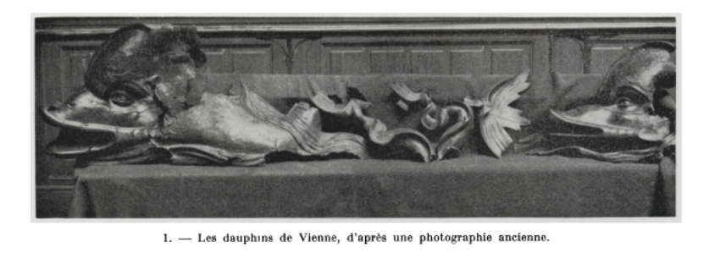
Context: The discovery of the Dolphins in Vienne, France
FIG 931
In 1839, while building a new quay on the riverbanks of the Rhône in Vienne, engineers using a pile driver unearthed a group of “imposing metallic fragments“ that represented a rare discovery: the fragmentary remains of a monumental gilded bronze relief representing swimming dolphins, consisting in two heads, a body in two fragments and three tails. This sculptural group, now known as the Great Dolphins of Vienne, is one of the rare surviving examples of such reliefs from the Roman world.
Conservation and surface coloration
Summary of
findings
Further resources
Home
Context
Main questions
Key new findings
Fabrication of casting model
Assemblage
X-ray
Casting map
Repairs
Synthetic map of features
Technical parameters
Further questions

Slide 3
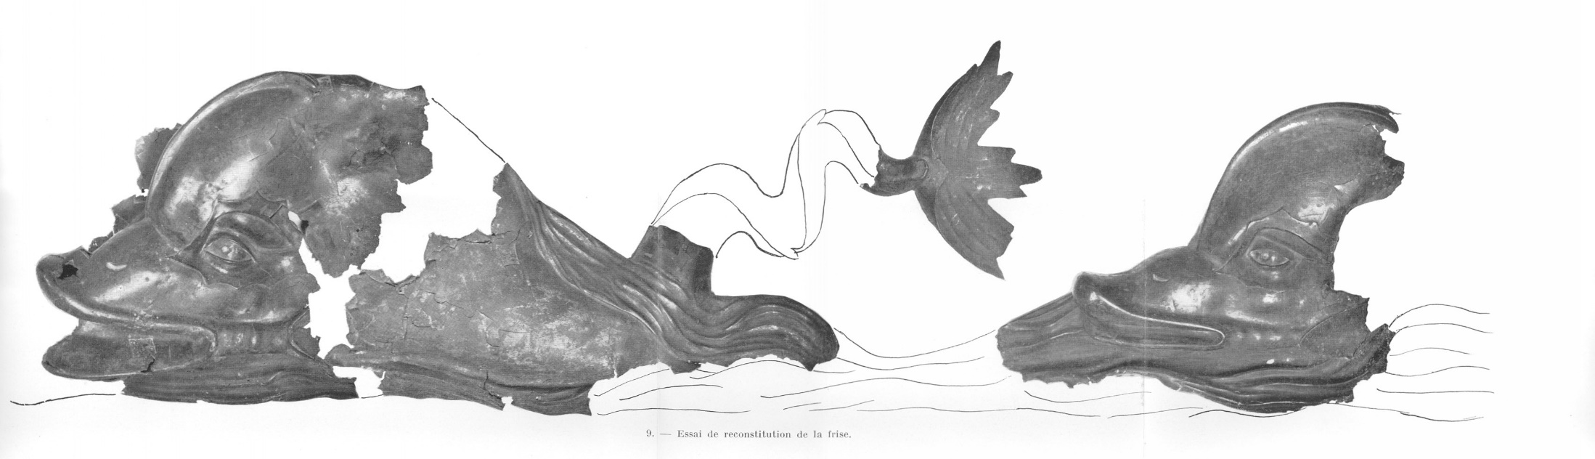
Context – Occasions for technical studies
FIG 946
The bronze fragments had been studied in the 1960s. Based on the three surviving tails, the proposed reconstruction of the relief’s original composition was a five-meter long frieze, with three dolphins swimming in a row. The visual examination made already clear that joins were present, and that the relief surface was extensively repaired.
In 2006, the Vienne museum decided to renovate the presentation of the Dolphins. Given the fragmentary nature and the complicated reading of the find, the museum requested a thorough technological probing as part of the conservation process, which addressed a series of questions about the sculptural group.
Conservation and surface coloration
Summary of
findings
Further resources
Home
Context
Main questions
Key new findings
Fabrication of casting model
Assemblage
X-ray
Casting map
Repairs
Synthetic map of features
Technical parameters
Further questions

Slide 4
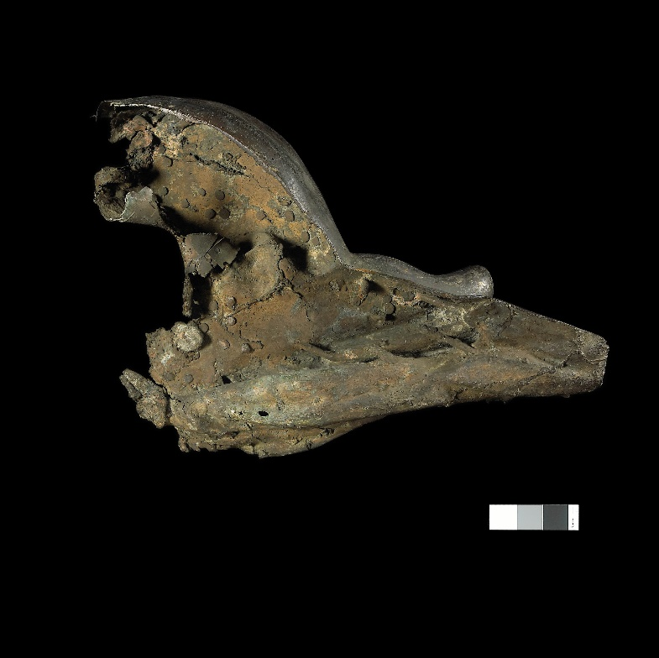
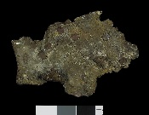
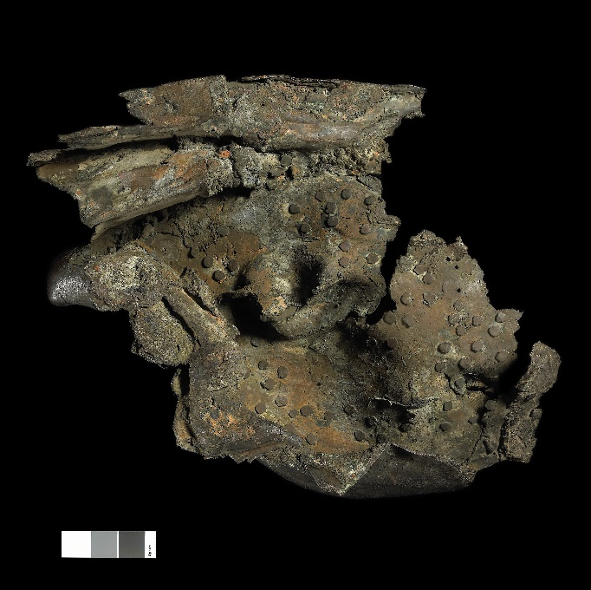
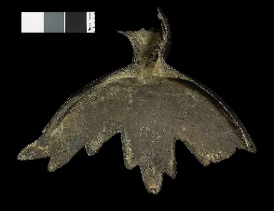
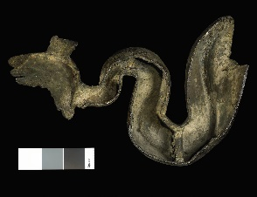
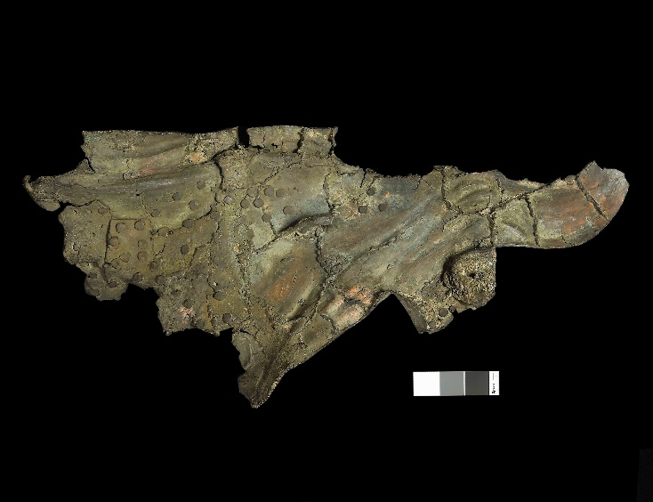
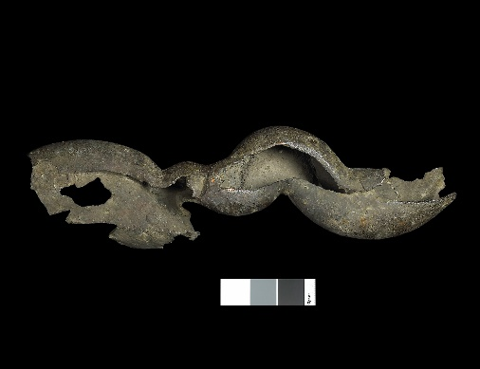
The main questions:
FIG 935
FIG 939
FIG 933
FIG 943
FIG 941
FIG 937
FIG 945
• How was it made?
• Why was it so heavily repaired?
• How do the surviving fragments fit together?
• What may the original composition of the full relief have been?
Conservation and surface coloration
Summary of
findings
Further resources
Home
Context
Main questions
Key new findings
Fabrication of casting model
Assemblage
X-ray
Casting map
Repairs
Synthetic map of features
Technical parameters
Further questions

Slide 5
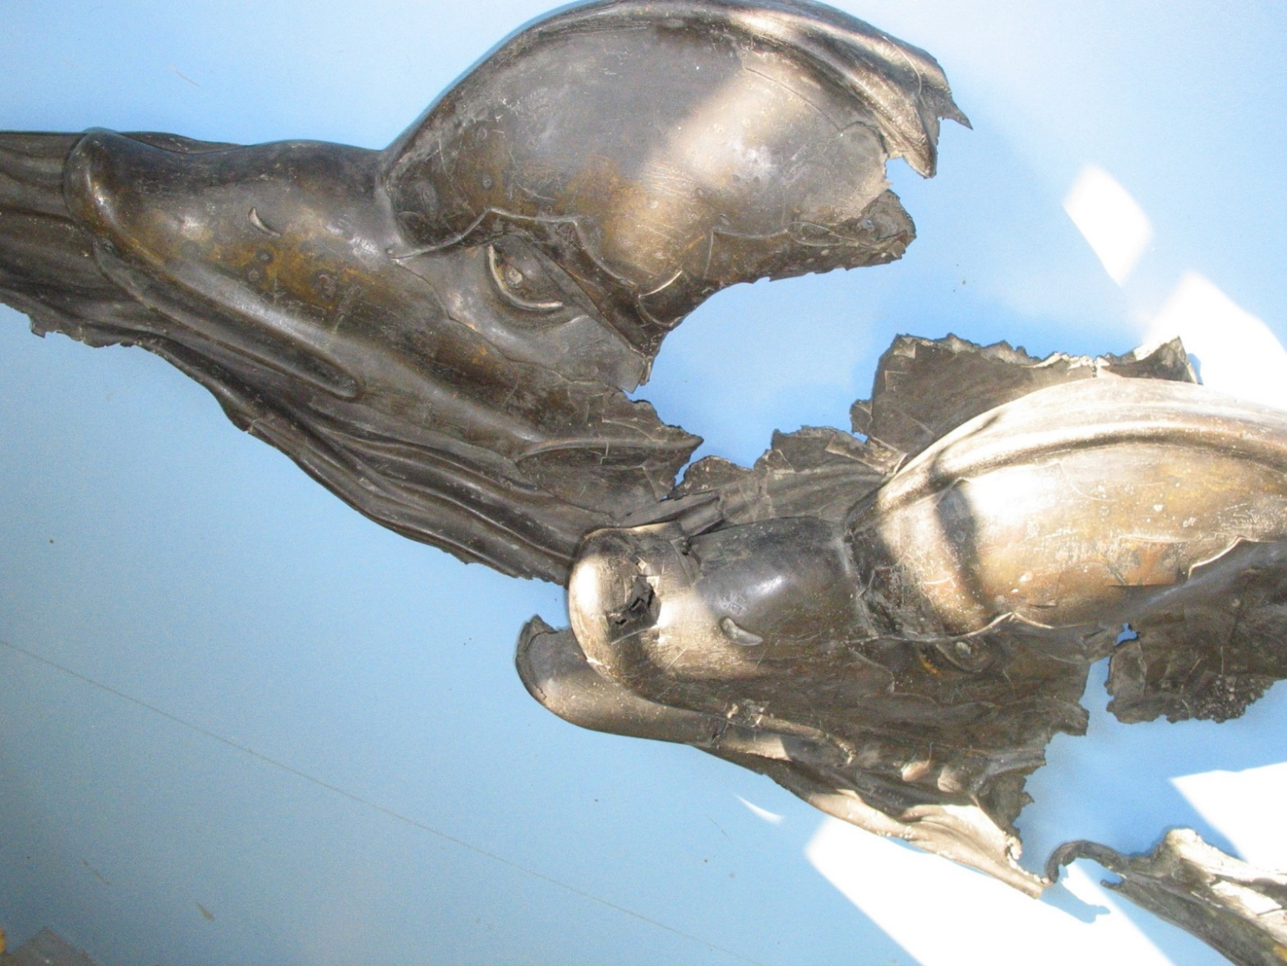
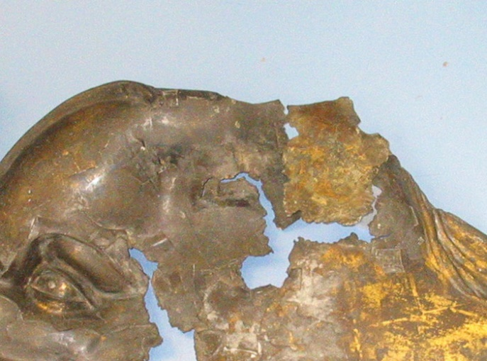
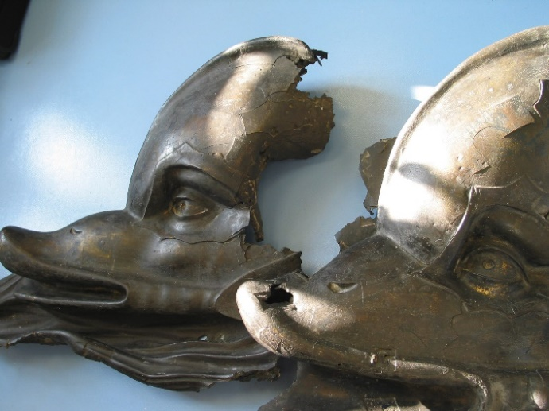
Visual examination: Some key new findings
cutout
FIG 948
connection
FIG 947
impact
FIG 949
By puzzling through the physical evidence on the fragments, the scientist-restorer team discovered a previously undetected connection between the two dolphin heads. At the same time, they noticed a neat cutout area at the top of the closer dolphin’s head.
It also became clear that the deformation and fragmentation of the relief was largely the result of violent and high speed impacts of a square tool of 13 x 13 cm² -- very probably the pile driver used in 1839.
Conservation and surface coloration
Summary of
findings
Further resources
Home
Context
Main questions
Key new findings
Fabrication of casting model
Assemblage
X-ray
Casting map
Repairs
Synthetic map of features
Technical parameters
Further questions

Slide 6
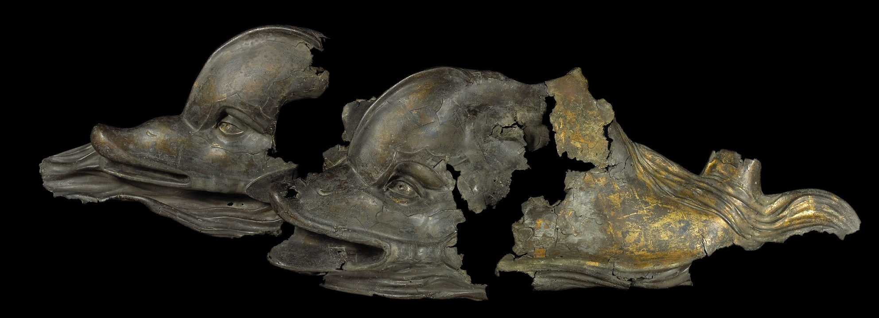
Interpretation 1: Reconsidering the original composition
FIG 950
Closer study of the fragments proved that the dolphins were originally side by side, hitched together, thereby fundamentally modifying the understanding of the compositional structure of the relief. The new understanding of the arrangement resolves some iconographical inconsistencies. The dolphin in the foreground turns his head towards the viewer while that of the background is presented in profile, reinforcing the perspective. In the same way, the wave rising behind the head of the foremost dolphin and descending over its body and tail should be read as a wave passing between the two dolphins. The cutout at the top of the foreground dolphin could correspond to the inset of a rider -- perhaps Eros.
The existence of three dolphin tail ends still raises questions. Were more than two dolphins hitched together? The newly-found perspective, the structure of the waves, and the presence of the upper edge preserved in most places make this an unlikely scenario. Instead, the tail could belong to one of a second pair of dolphins, or -- given how widely it is splayed -- to an unhitched, frolicking dolphin diving into the waves.
Conservation and surface coloration
Summary of
findings
Further resources
Home
Context
Main questions
Key new findings
Fabrication of casting model
Assemblage
X-ray
Casting map
Repairs
Synthetic map of features
Technical parameters
Further questions

Slide 7
Evidence of fabrication : How was the wax model made?
FIG 772
FIG 773
Examination of the rear surfaces of the fragments revealed evidence that the sculptor worked in wax and had access to what would have been formed as a wax shell in a mold, in other words by an indirect lost wax casting process. One finds, for instance, a series of tool marks that were formed by dragging the tool through a malleable material -- and were ultimately translated into bronze. Further evidence of this are the numerous sprues that have been preserved on the internal surface, for instance connecting high points in the relief on the back of the dolphin’s head.
Conservation and surface coloration
Summary of
findings
Further resources
Home
Context
Main questions
Key new findings
Fabrication of casting model
Assemblage
X-ray
Casting map
Repairs
Synthetic map of features
Technical parameters
Further questions

Slide 8
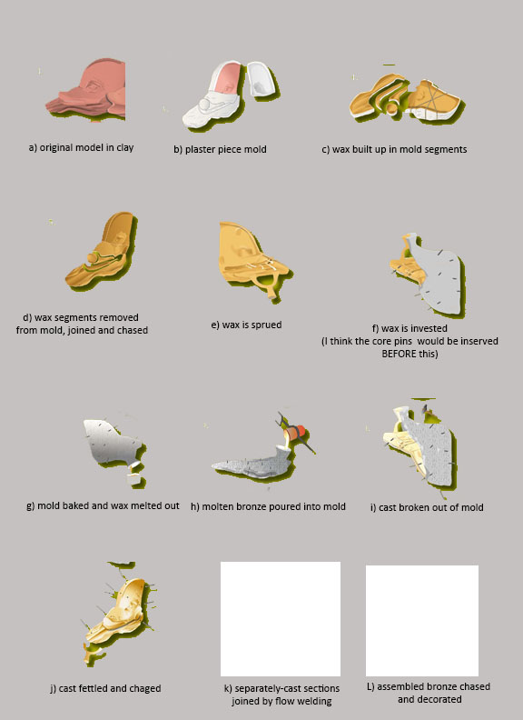
Indirect lost-wax casting in segments: example of the dolphin head in the background
FIG 783 IS BEING REDONE
Conservation and surface coloration
Summary of
findings
Further resources
Home
Context
Main questions
Key new findings
Fabrication of casting model
Assemblage
X-ray
Casting map
Repairs
Synthetic map of features
Technical parameters
Further questions

Slide 9
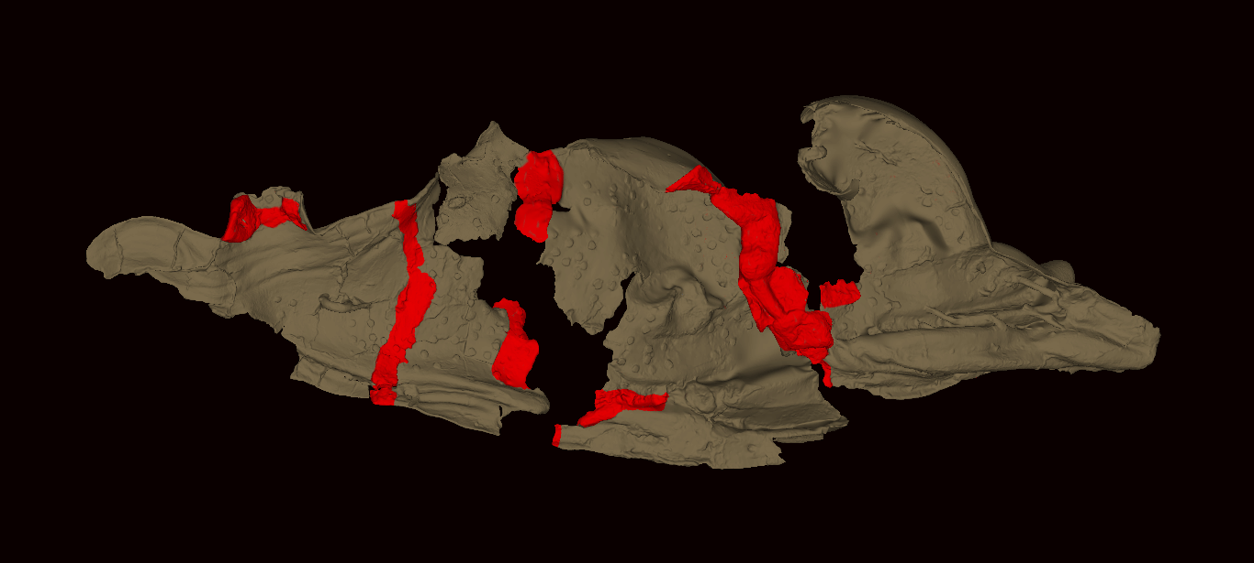
Evidence of fabrication: How were the sections of the relief assembled?
FIG 952
video of fusion welding lab experiment
Once all the separate parts were cast, the vast puzzle of primary castings had to be assembled. To achieve this, the Roman foundrymen responsible for the relief used flow fusion welding – a technique learned from Ancient Greece where it had been practiced since the 5th cent. BC. With its 3+ linear meters of weld joins, the Vienne dolphin relief bears exceptional testimony of this complicated method of assembly. Considering that the remains of the relief are only a small part of the original relief, then we take the measure of the exceptional dimension and ambition of this major work of sculpture. The recent scientific study and characterization of ancient welds, with experimental simulations in the laboratory, have shed more light on the long-forgotten process (link to the video of the lab experiment, and to chapter XX).
Conservation and surface coloration
Summary of
findings
Further resources
Home
Context
Main questions
Key new findings
Fabrication of casting model
Assemblage
X-ray
Casting map
Repairs
Synthetic map of features
Technical parameters
Further questions

Slide 10
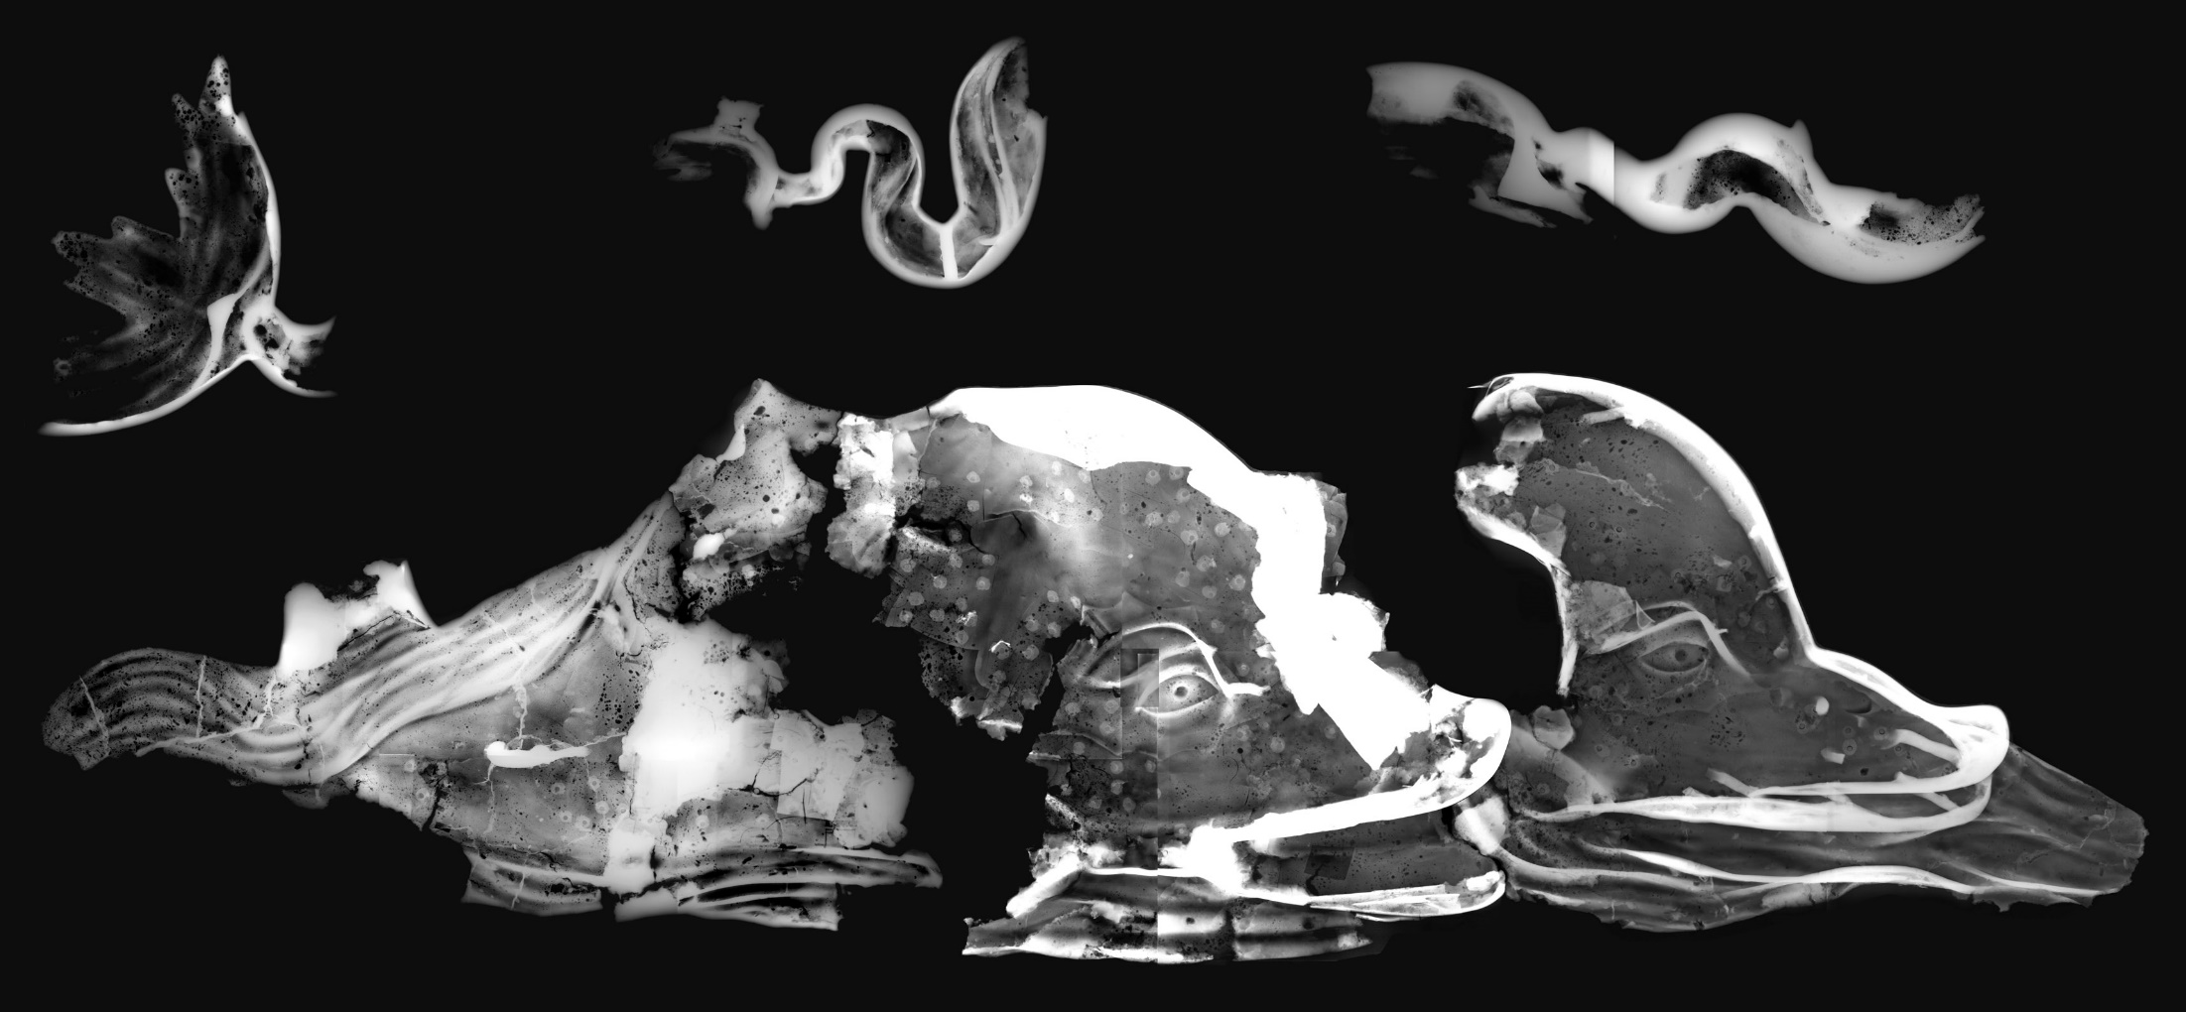
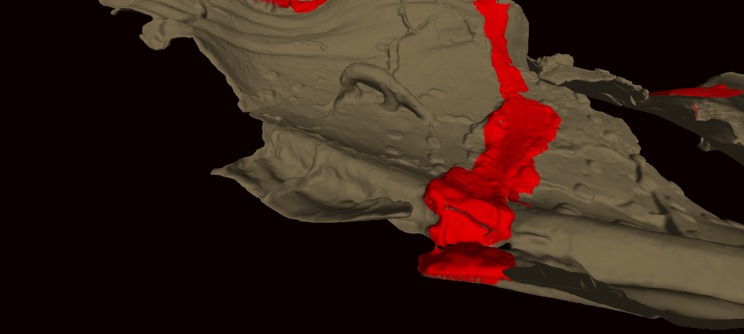
Evidence of fabrication : How were the segments of the relief assembled? (2)
FIG 959?
FIG 954
FIG 953
Some welds measure more than a staggering 70 cm in length -- The fact that these joins were achieved in a single pour bears witness to the great mastery of the founder. The welds were very wide and the flow of metal was contained, probably by channeling the welding metal with a refractory mold covering the whole weld path. Despite the channeling some leakage did occur (see also techno diagram slide 14).
Bulk alloy analyses by ICP-AES indicated some variation in the alloy used for the different sections. Metallographic examination confirmed flow fusion welding for the joins with: primary casting metal 3-4%Sn, 5%Pb and welding metal 1-2%Sn, 5% Pb, which is a bit of a surprise since the tin lowers the range of the melting temperature and one would, therefore, expect the weld to be higher in tin.
Conservation and surface coloration
Summary of
findings
Further resources
Home
Context
Main questions
Key new findings
Fabrication of casting model
Assemblage
X-ray
Casting map
Repairs
Synthetic map of features
Technical parameters
Further questions

Slide 11
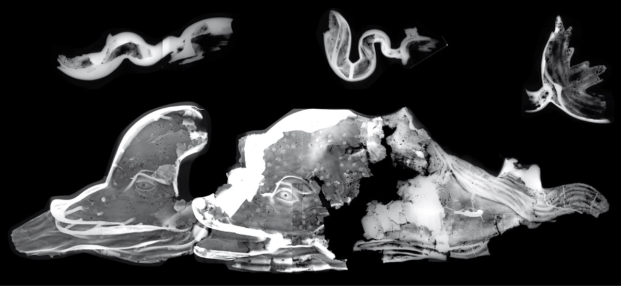
Evidence of fabrication : X-radiography
FIG 815
X-radiography (link to Vol. 2, ch. 2) provided evidence of the assemblage: the welds show up as lighter bands, reflecting the thicker -- and therefore denser – metal joins. It also confirmed that the metal walls of the separately-cast sections are relatively thin and even across the board (measured at 4-6 mm), including the mouth area even though it is in high relief.
The vast amount of repair work that the relief necessitated is also visible. The edges of the many rectangular patches that were inset into the outer surface to repair small flaws are recognizable as are the copper rivets, which will be discussed further along.
Conservation and surface coloration
Summary of
findings
Further resources
Home
Context
Main questions
Key new findings
Fabrication of casting model
Assemblage
X-ray
Casting map
Repairs
Synthetic map of features
Technical parameters
Further questions

Slide 12
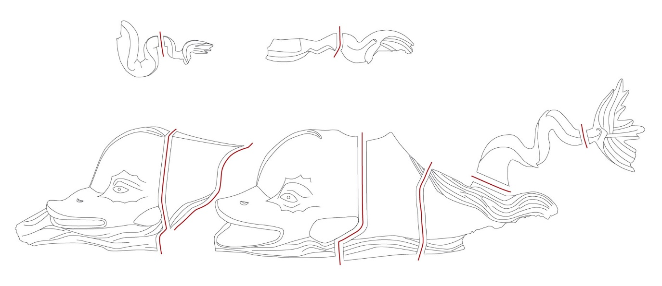
Interpretation 2: Proposing a «casting map »
FIG 951
Roman foundrymen did not have the technological know-how to cast large and complex pieces like the Vienne dolphin relief in a single pour. Rather, they cast larger sculptures in smaller sections (primary castings) and then joined the metal parts by welding with secondary castings (see vol1 ch5 §XX). Thorough examination of the fragments and corresponding radiographs to locate the joins led to the proposal of a “casting map,” which shows how the extant pieces would have originally been cast -- in 11 sections.
Conservation and surface coloration
Summary of
findings
Further resources
Home
Context
Main questions
Key new findings
Fabrication of casting model
Assemblage
X-ray
Casting map
Repairs
Synthetic map of features
Technical parameters
Further questions

Slide 13
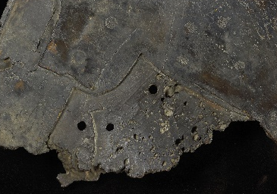
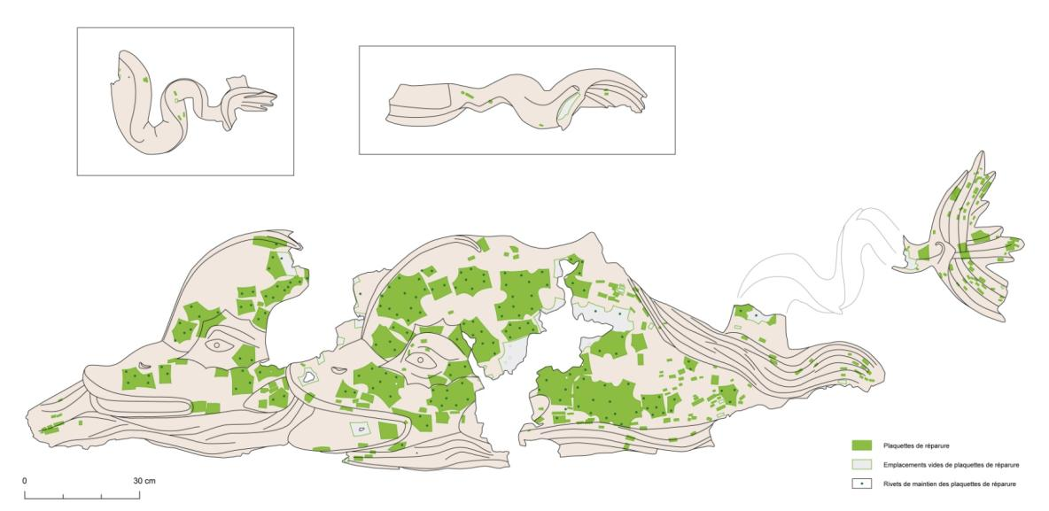
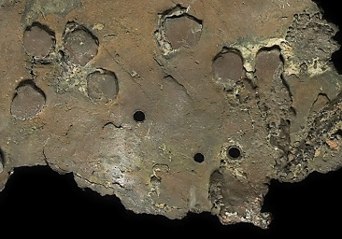
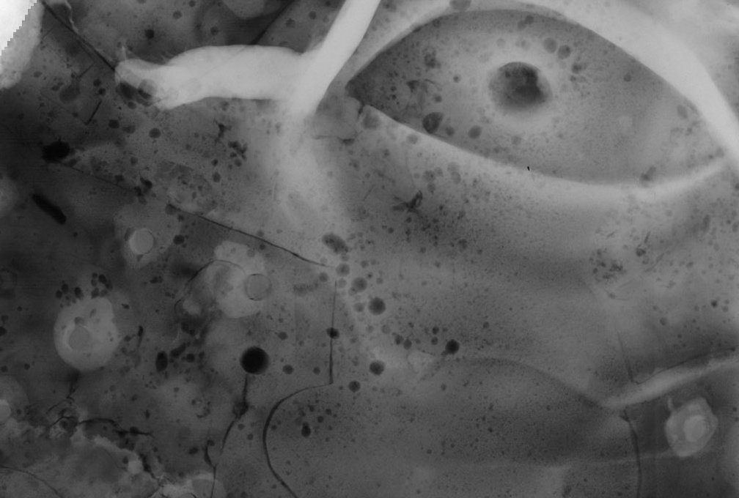
Evidence of fabrication: How was the cast repaired?
FIG 958
FIG 959
FIG 956
Large ancient bronzes, even exceptional commissions, exhibit casting defects and a large number of repairs. The Great Dolphins of Vienne are in this respect no exception, as it is heavily flawed and the repairs cover 25% of the exterior surface. Once covered by gilding, these would have been nearly invisible.
The external bronze skin is riddled with porosity – endemic fine holes that formed in the metal during casting (and are clearly visible in the radiographs). Visual and X-ray observation of internal and external surfaces (enhanced by their cleaning during conservation) revealed no less than 265 bronze patches. Many of the largest ones are fastened with (a total of 178) copper rivets.
FIG 957
5 cm
Conservation and surface coloration
Summary of
findings
Further resources
Home
Context
Main questions
Key new findings
Fabrication of casting model
Assemblage
X-ray
Casting map
Repairs
Synthetic map of features
Technical parameters
Further questions

Slide 14
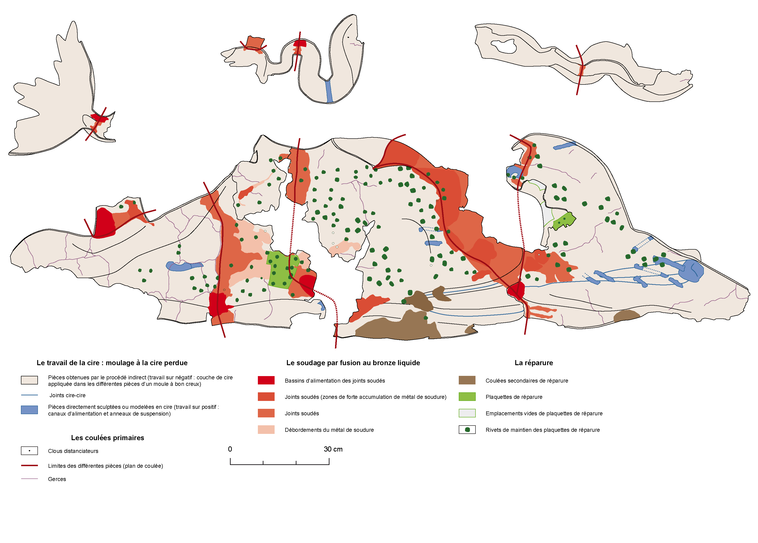
Interpretation: Summary of main technological features observed at the back of the dolphins
FIG 955
Conservation and surface coloration
Summary of
findings
Further resources
Home
Context
Main questions
Key new findings
Fabrication of casting model
Assemblage
X-ray
Casting map
Repairs
Synthetic map of features
Technical parameters
Further questions

Slide 15
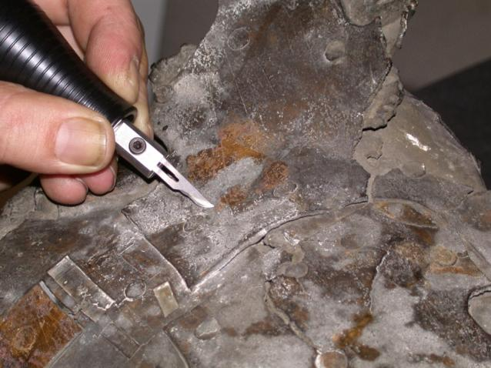
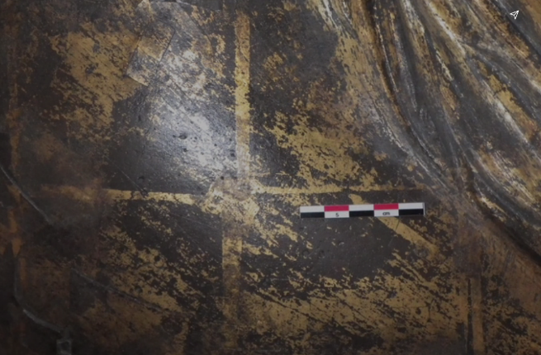
Conservation treatment and surface decoration (1)
The careful examination of all of the fragments also served to assess their structural and physico-chemical condition and any alterations of the metal in view of the second objective of the conservation intervention -- the careful mechanical cleaning of the surface of the dolphins. There was no question of attempting to address the deformations or fill losses. Focus was on the removal of the bronze corrosion products that masked the entire surface. It was decided early on to clean the reverse as well in order to enhance the readability of technical features and learn as much as possible about the manufacture of the object.
FIG 961
FIG 962
During the cleaning, which was mostly done mechanically with an ultrasonic scalpel, it became clear that below the outer corrosion crust, the bronze surfaces of the dolphins still preserved much of an original gilding, which had been applied as gold leaf in a geometric pattern of 12cm-wide squares overlapping neatly at the edges. The main challenge in laying bare the gilding was in avoiding damage to this extremely fine layer, given its fragility and the corrosion state of the underlying bronze.
Conservation and surface coloration
Summary of
findings
Further resources
Home
Context
Main questions
Key new findings
Fabrication of casting model
Assemblage
X-ray
Casting map
Repairs
Synthetic map of features
Technical parameters
Further questions

Slide 16
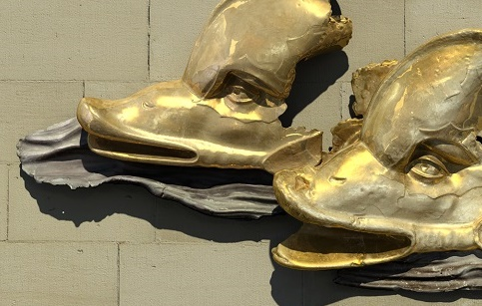
Conservation treatment and surface decoration (2)
FIG 960
Also revealed was that the decorative layer was applied selectively: the waves bore no trace of gold. Instead, the surface of the waves was only slightly corroded and covered with a very dark, brown to black, homogeneous, protective layer. Whether it was deliberately patinated black to create a dramatic contrast with the gilded dolphins remains to be determined. 3D virtual reconstruction shows what the possible original dichromatic appearance might have looked like.
Conservation and surface coloration
Summary of
findings
Further resources
Home
Context
Main questions
Key new findings
Fabrication of casting model
Assemblage
X-ray
Casting map
Repairs
Synthetic map of features
Technical parameters
Further questions

Slide 17
Summary of Findings
The results of the technological study allowed the fragments to be reconstituted to create an unexpected new sense of perspective, spatial depth, and movement.
2) A new iconographical interpretation was proposed for these rare remains of an important architectural ornament: it was not a 5+ m long frieze of dolphins, but a hitch of two dolphins, probably pulling a marine chariot.
3) The original gilded surfaces were uncovered during conservation treatment lending more visual power and sophistication to the relief.
4) Furthermore, the technological examination showed that the preserved fragments were created in a unified manner and the product of one workshop, as evinced by:
Unified production of the lost wax model with similarly thin and even wall thicknesses
Similarity in the kind and quantity of casting defects (usual in the Roman period) and their repair
Same alloy
Same variant of flow fusion-welding over more than 3+ m of linear joins
Conservation and surface coloration
Summary of
findings
Further resources
Home
Context
Main questions
Key new findings
Fabrication of casting model
Assemblage
X-ray
Casting map
Repairs
Synthetic map of features
Technical parameters
Further questions

Slide 18
Synopsis of technical parameters
The musée des Beaux Arts et d'Archéologie de Vienne coordinated the whole operation. The C2RMF took charge of developing, setting up and carrying out all the examinations and analyses. The restoration project was conducted by the CREAM of Vienne (Center for Restoration and Municipal Archaeological Studies). The objectives and issues of the restoration project were determined and discussed collegially by the three partners.
Photography The photographs were taken by the C2RMF studios using a hi-resolution Hasselblad numerical camera.
X-ray Radiography All radiographic imaging was done at the C2RMF using a Isovolt 420 kV X-ray tube.
Bulk metal analyses by atomic emission spectrometry (ICP-AES) Drillings and analyses were done at the C2RMF using a Perkin-Elmer Optima 3000 SC spectrometer. A protocol developed specifically for elemental analysis of cultural heritage copper-based artefacts has been used (Bourgarit and Mille 2003).
3D scanning and reconstruction were done by Archeovision, using lasergrammetry and 3D modeling
Conservation and surface coloration
Summary of
findings
Further resources
Home
Context
Main questions
Key new findings
Fabrication of casting model
Assemblage
X-ray
Casting map
Repairs
Synthetic map of features
Technical parameters
Further questions

Slide 19
Further Questions
What did the rest of the relief represent?
Were the rivets a distinctive way of securing patches, or commonly used?
Was the dark patina on the waves deliberate?
Was the low-tin content (1 to 4%) a common use in Gallo-roman large bronze statues?
Conservation and surface coloration
Summary of
findings
Further resources
Home
Context
Main questions
Key new findings
Fabrication of casting model
Assemblage
X-ray
Casting map
Repairs
Synthetic map of features
Technical parameters
Further questions

Slide 20
Further resources:
https://c2rmf.fr/actualite/les-grands-dauphins-de-vienne
Azéma, A., Mille, B., Echegut, P., & De Sousa Meneses, D. (2011). An experimental study of the welding techniques used on the Greek and Roman large Bronze Statues. Historical Metallurgy, 45(2), 71‑80.
Azéma, A., & Mille, B. (2013). Un point sur la technique de fabrication des grands bronzes antiques. L’actualité chimique, 377, p. 43‑44.
Azéma, A. (2013). Les techniques de soudage de la grande statuaire antique en bronze : étude des paramètres thermiques et chimiques contrôlant le soudage par fusion au bronze liquide (Thèse de doctorat, spécialité Chimie physique et chimie analytique de Paris Centre (ED 388), Université Pierre-et-Marie-Curie (Paris VI), https//tel.archives-ouvertes.fr/tel-00918829
Boucher, S. (1964). Les grands dauphins de bronze doré du Musée municipal de Vienne (Isère), Gallia 22(1), p. 23-35.
Mille, B., & Robcis, D. (2012). Le cas des grands bronzes antiques : étudier pour restaurer ou restaurer pour étudier ? In P.-Y. Kairis, B. Sarrazin, & F. Trémolières (Éd.), La restauration des peintures et des sculptures, Paris: Armand Colin, p. 101-115.
Mille, B. (2017). D’une amulette en cuivre aux grandes statues de bronze, évolution des techniques de fonte à la cire perdue, de l’Indus à la Méditerranée, du 5e millénaire au 5e siècle av. J.-C. (Thèse de doctorat en cotutelle de l’ED 395 « Milieux, cultures et sociétés du passé et du présent » en préhistoire (Nanterre), et du département de géosciences en archéométrie (Fribourg), Université de Paris-Nanterre et Université de Fribourg), http://www.theses.fr/2017PA100057
Conservation and surface coloration
Summary of
findings
Further resources
Home
Context
Main questions
Key new findings
Fabrication of casting model
Assemblage
X-ray
Casting map
Repairs
Synthetic map of features
Technical parameters
Further questions

